Slide 1
THE FAMILY OF YAHWEH
- Natural, Spiritual and Eternal

Slide 2
Class Outline
Introduction
Foundation of the Natural Family
Spiritual Family – as revealed in the Covenants of Promise & God’s Prophetic Name
Two Seeds, Two Lines, Two Ways of Thinking
Tent Dwelling – A Key Characteristic
Spiritual Israel – Enlargement of God’s Family
God’s Eternal Family & Figure of Marriage

Slide 3
Introduction
God’s purpose with His creation
Our view of prophecy and framework
Our state of mind as related to our lives in the Truth and how we think about the future

Slide 4
Bro. John Thomas Herald of the Kingdom, 1845, pp. 84-85
“Men were not ushered into being for the purpose of
being saved or lost! God-manifestation, not human
salvation, was the great purpose of the Eternal
Spirit. The salvation of a multitude is incidental to
the manifestation but was not the end proposed.”

Slide 5
Yahweh Manifested In A Family
“The Eternal Spirit intended to enthrone Himself upon the earth, and in so doing, to develop a Divine family from among men, every one of whom shall be Spirit, because born of the Spirit, and that this family shall be large enough to fill the earth, when perfected to the entire exclusion of flesh and blood.”
John Thomas
Herald of the Kingdom, 1845, pp. 84-85

Slide 6
Is Prophecy a First Principle?
Yes!
Everything in Scripture that deals with the future (from the time that it was written or declared) in the big picture is prophecy.
Everything said about Christ in the OT is/was prophetic, starting with Genesis 3:15.
Everything written about the return of Christ and the coming Kingdom on earth – included in our Statement of Faith.

Slide 7
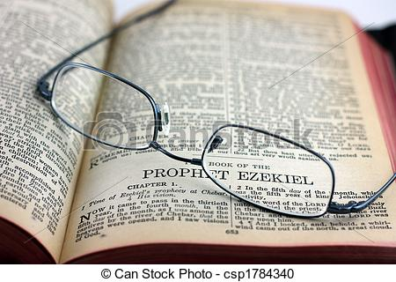
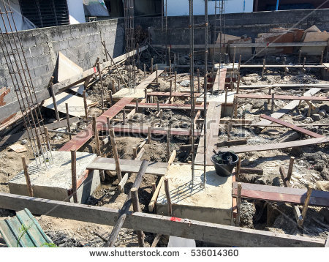
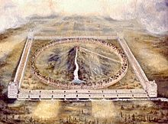
Construction in Progress

Slide 8
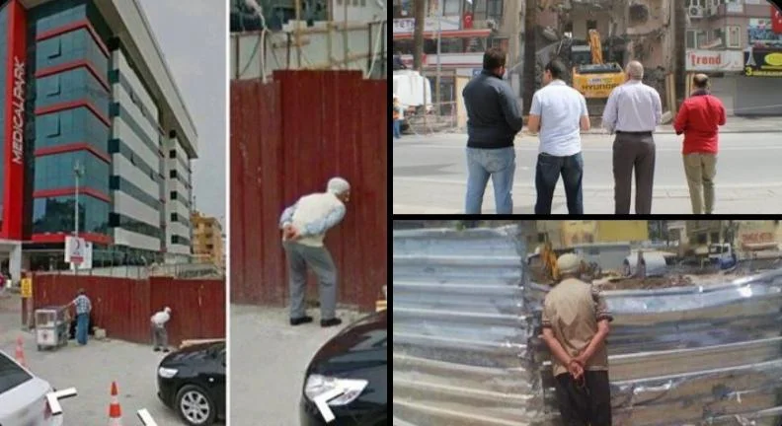
An Analogy

Slide 9
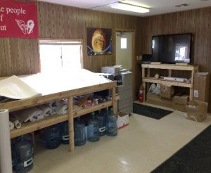
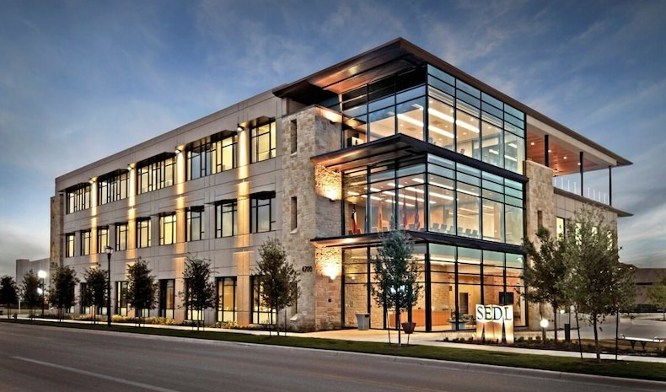

Slide 11
Framework of Bible Prophecy
God-Manifestation
Purpose for His Creation
His Promises & Covenants
The Two Seeds & Two Lines of Descent

Slide 12
Traits of Successful People
Future-oriented
Bias towards action
Solution and not problem-oriented

Slide 13
We become what we think. We become what we think about much of the time.
Bro. LG Sargent, “Teaching of the Master”

Slide 14
Family Terms in the Bible
Word | Old Testament | New Testament | Total
Family(ies) | 296 | 1 | 297
House | 1820 | 206 | 2026
Household | 48 | 13 | 61
Child | 144 | 61 | 205
Children | 1666 | 156 | 1822
Seed | 225 | 55 | 280
Tribe(s) | 328 | 26 | 354

Slide 15
Hebrew for Family
Bayith (H1004) – house, home, family
Refers to several generations; can include non-family members in the same household or “father’s house”
Mispachah (H4940) – a family; i.e., circle of relatives; a tribe or people; kindred
Larger than a bayith; kinship unit comprised of related fathers’ houses; aka – a “clan”
All the related clans comprise a ‘tribe’

Slide 16
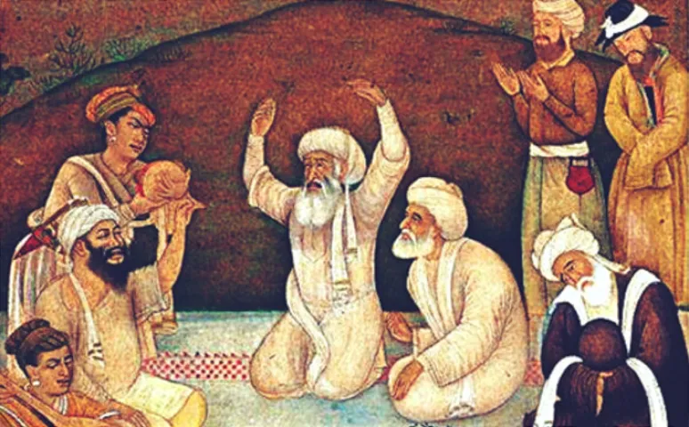
Eastern Family Culture
Endogamous* marriage
Patrilineal succession and
Inheritance – to eldest son
* The custom of marrying only within the limits
of a local community, clan or tribe

Slide 17
Family Terms in the Bible
Word | Old Testament | New Testament | Total
Family(ies) | 296 | 1 | 297
House | 1820 | 206 | 2026
Household | 48 | 13 | 61
Child | 144 | 61 | 205
Children | 1666 | 156 | 1822
Seed | 225 | 55 | 280
Tribe(s) | 328 | 26 | 354

Slide 18
Greek New Testament Words
Patria (G3965) - Lineage, as in paternal descent; a group of families, or a whole race or nation
“family” (Eph. 3:15)
“lineage” (Lk. 2:4)
“kindred” (Acts 3:25)
Other NT Words
G2322 – “household”
G3609/3615– “a relative”/”relatives” (of own house or household)
G3610 – “fellow resident” (of same household)
G3613/3614 – “home”, “household”
G3616/3617 – “head of family”, “householder”, “goodman or master of the house”
G3624 – “dwelling” or my implication – “family”, “home”, “household” or “temple”

Slide 19
Specific Family Member Terms
Word | Old Testament | New Testament | Total
Father(s) | 1237 | 438 | 1675
Mother(s) | 232 | 96 | 328
Son(s) | 3144 | 354 | 3498
Daughter(s) | 547 | 34 | 581
Brother(s) | 295 | 1 | 1822
Sister(s) | 110 | 25 | 135
Seed | 225 | 55 | 280
Tribe(s) | 328 | 26 | 354

Slide 21
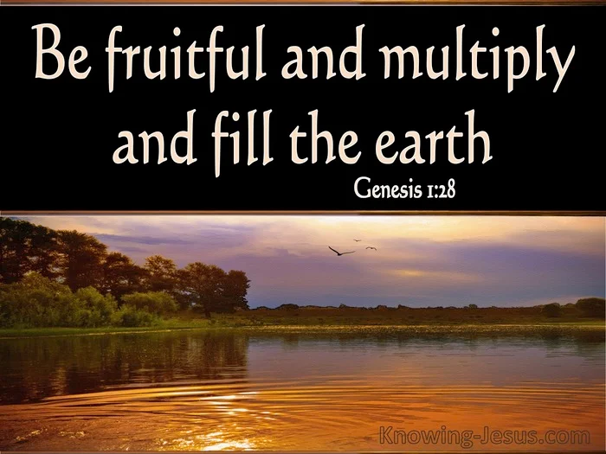

Slide 23
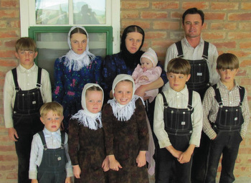
Definitions of “Traditional Family”
Dictionary - “a primary social group consisting of parents and their offspring, the principle function of which is provision of its members.”
Working Biblical – “the God-ordained basic unit of society that has parental headship and discipline and is established for the purpose of enjoying a common life through working, caring, sharing, serving and ministering to God, others and itself.”

Slide 25
The Building of a Family
As one places stone upon stone [eben] to construct a house [bayith], so parents build son [ben] or child upon child to build a family [bayith].

Slide 26
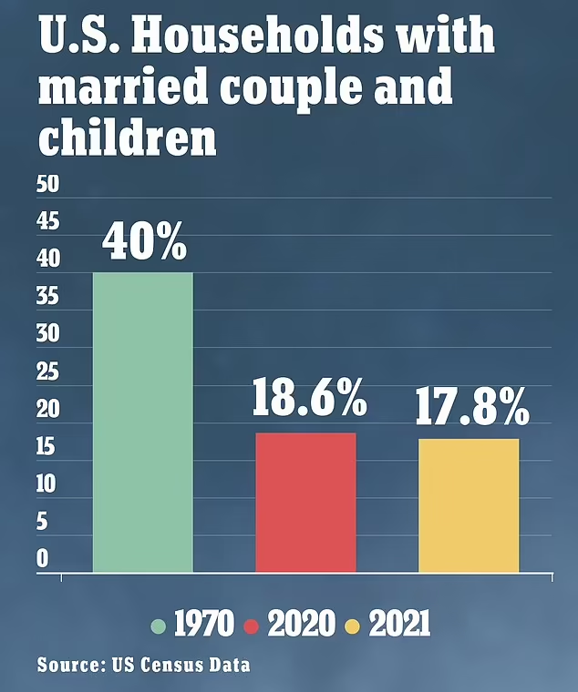

Slide 29
Ephesians 6:1-4
Children, obey your parents in the Lord: for this is right.
Honour thy father and mother; which is the first commandment with promise;
That it may be well with thee, and thou mayest live long on the earth.
And, ye fathers, provoke not your children to wrath: but bring them up in the nurture and admonition of the Lord.

Slide 30
God’s Purpose – Centered in A Family
From the beginning, our Father’s will was that He be manifested in a “multitude of mighty ones”
A Family – that would reflect His character and that would eventually fill the earth with His glory
This purpose is at the very center of the Truth in which we place our faith and our hope in.

Slide 31
THE FAMILY OF YAHWEH
As Revealed in Yahweh’s Name, the Covenants of Promise & Prophecy

Slide 32
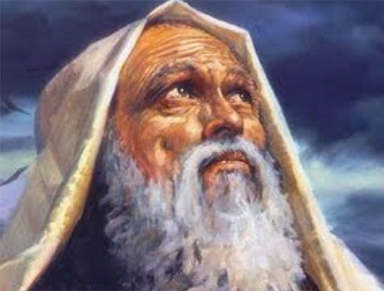
Family of God in the Promises to:
Abraham – Genesis 12:1-3
Isaac – Genesis 26:2-4
Jacob – Genesis 28:12-14

Slide 33
Exodus 3:3-6

Slide 34
The I AM of His Prophetic Name

Slide 35
Yahweh Elohim of Abraham, Isaac and Israel
David’s Prayer - 1 Chronicles 29:13-18
Elijah’s Prayer - 1 Kings 18:36
Hezekiah’s Decree – 2 Chronicles 30:6
Christ’s Reply to Sadducees – Luke 20:34-37

Slide 36
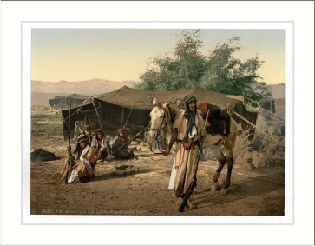
Why these 3 men?
Hebrews 11:8-9
Faith
Obedience
Sojourning to a strange country and…
Dwelling in tabernacles

Slide 37
Hebrews 11:16
God is not ashamed to be called their God
“called” in that same phrase literally means “surnamed”
(Strongs G1941)

Slide 38
The Family of God
Yahweh Revealed As a Father through Abraham
Gen. 17:1-5

Slide 39
Abraham – Father of a Multitude
Yahweh revealed as a father through him
Romans 4:11-13, 16-18
Abraham - presented in the scriptural record as the father of a multitude from whom God’s primary blessing would flow, and in whom the promises would originate.
Yahweh led Abraham through the emotional
experience of fatherhood, so that he might relate to
the very feelings of God, as the father of his own
beloved son.
Notes:
39

Slide 40
Yahweh – Spiritual Father of His Family
Psalm 103:13-14
1 Corinthians 8:6
Isaiah 63:16 and 64:8 – the Nation of Israel
1 Chronicles 29:10-11 – Spiritual Israel

Slide 41
Ehyeh Asher Ehyeh Exodus 3:14
I WILL BE WHO I WILL BE
Exodus 3:12 – Certainly I WILL BE* with thee;
* Same Hebrew word, Ehyeh, as in verse 14

Slide 42
Ehyeh Asher Ehyeh
Asher - ‘who’, the relative pronoun in this name, is both singular and plural, masculine and feminine.
It will therefore stand for ‘ten thousand times ten thousand’, as well as for two or three persons. ‘to be’.
In this memorial, the Eternal Spirit is the ‘I’, and the Elohim of Abraham, Isaac, and Jacob, are the ‘who’, of whom it is memorialised they ‘shall be’.
John Thomas, Phanerosis, pp. 59-60

Slide 43
Unto All Generations
Exodus 3:15 – “my memorial unto all generations”
Roth – “unto generation after generation”
GLT – “from generation to generation”
John Thomas – “unto a generation of the race”
Generation: The circle of a man’s lifetime, from birth to death… More frequently, of the circle of a mans life from his conception and birth until the conception and the birth of his offspring… By a natural transition this word is used widely with a metaphorical sense to indicate a class of man distinguished by a certain moral or spiritual character.
Theological Wordbook, Vol. 1, p. 186

Slide 44
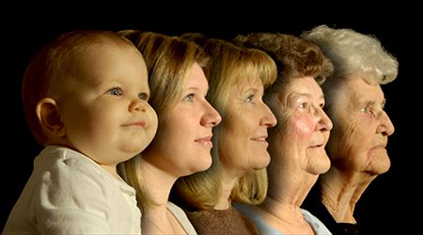
Unto All Generations
The Divine name was a prophecy of His intention with only one generation. This is the special generation of the saints, which is taken from all the generations of time – the generation of Yahweh’s own, special family. Those that belong to this ‘generation of the race’ know His Name.
Psalm 22:30
Psalm 24:3-6

Slide 45
What’s in a Name?

Slide 46
Yahweh As a Father
-Belonging to His Family
The term Father when applied to Yahweh, is highly expressive of His intention to create offspring.
Because they are His offspring, they display the family characteristics of the Father. His children, by their demeanour, speech and attitude reflect their origin, and can therefore be recognised as belonging to His family. They preserve the ‘memorial of the name’, as ‘the generation of the race’.
We have been created in the ‘image’ and ‘likeness’ of God. It was the intention of Yahweh from the beginning therefore to populate the earth with His own family who think and act and look like Him. Genesis 1:26-27

Slide 47
The Family of Yahweh
Declared in a Son

Slide 48
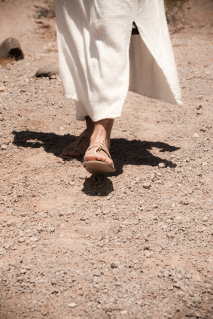
A Model for God’s Family to Follow
Proverbs 30:1,4 The Prophecy of Agur
What is his name and what is his son’s name, it thou canst tell?
The Father knew that the multitudinous seed promised to Abraham must have a pattern to follow for it to become His spiritual family.

Slide 49
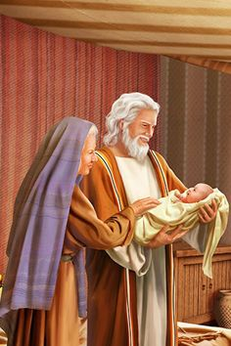
The Wonderful Birth of the
Miraculous Son
Hebrews 11:17 - Was Isaac Abraham’s ‘only begotten son’?
Genesis 21:1-5, Romans 4:19-21 - The record of the birth of Isaac declares that he was a child born by Divine intervention. Since both parents were incapable of producing a child, Isaac could only have been begotten by the operation of Divine power.
John 1:14,18, 3:16, 18, 1 John 4:9 - The phrase is applied exclusively elsewhere only to Christ, to indicate, as with Isaac, the special and miraculous circumstances of his birth by Divine intervention.

Slide 50
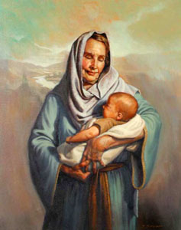
The Promised Son and the
Joyful Mother
Genesis 21:6-7, Luke 1:45,48 – Sarah rejoiced in the birth of Isaac, providential hand of God upon her, saw ahead to the promised son to come, of whom her own child was but a foreshadowing as well as to a whole generation to come.
Genesis 21:9-10 – Sarah wanted a godly environment for the development of Isaac as his father’s son.
Hebrews 11:11-12

Slide 52
THE FAMILY OF GOD
Yahweh Revealed
through a Multitude

Slide 53
Yahweh – The Elohim Of Jacob
Yahweh proclaimed through a multitude
Genesis 28:1-4, Genesis 30:30
Genesis 35:10-11, Genesis 48:3-4
Luke 1:33, Acts 7:8, 14-15
Jacob is the grandson through whom the promises would be multiplied and the channel through whom God’s family would increase.
Jacob was led by Yahweh through the difficulties and trials of family life, which shaped and fashioned his character.
Yahweh was declared in the multitude of Jacob’s offspring.
Notes:
53

Slide 54
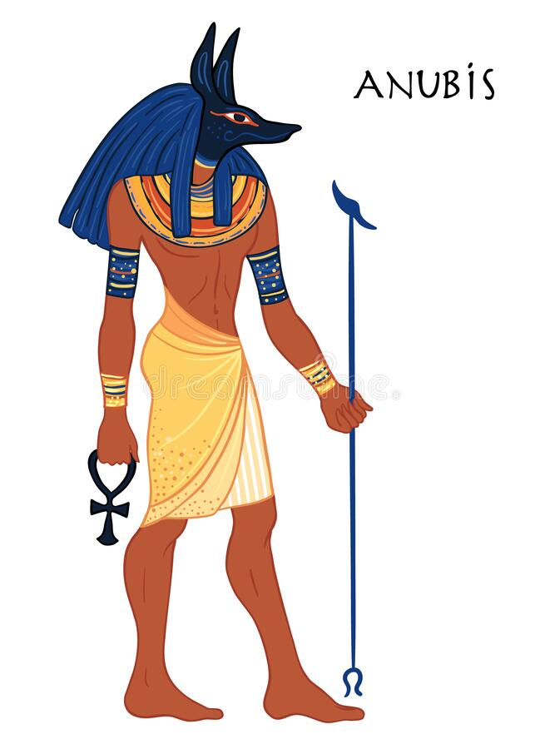
The Multitudinous Seed Developed
in Egypt
Genesis 28:3 – And God Almighty bless thee and make thee fruitful, and multiply thee, that thou mayest be a multitude of people.
The fulfilment of this promise however awaited the death of the patriarchs, and was accomplished in Egypt (Genesis 46:1-3; Exodus 1:5-7).
What does Egypt symbolize?
Egyptian god of evil and darkness

Slide 55
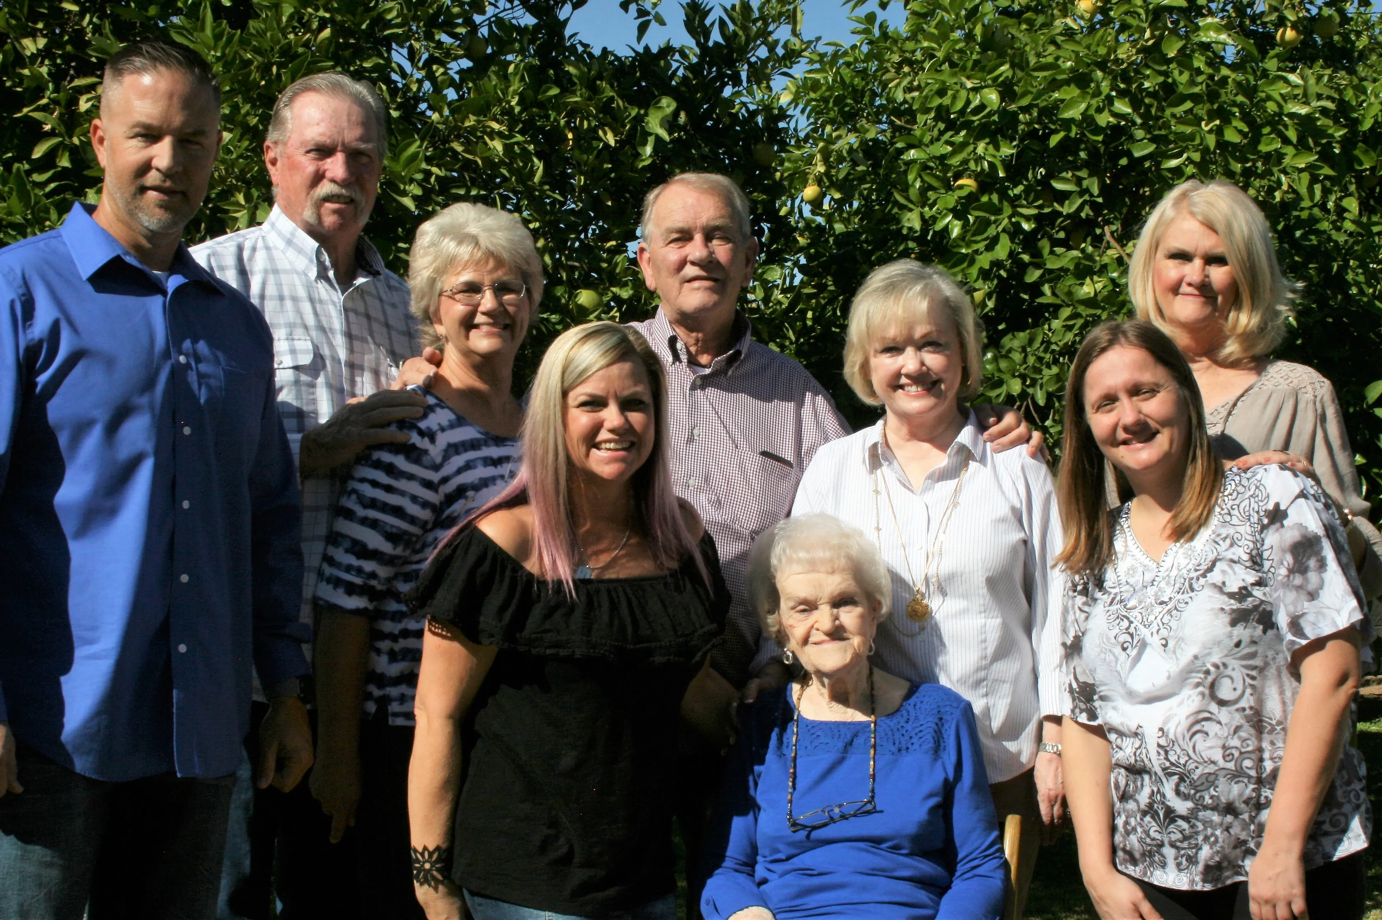
Family Likeness

Slide 56
Manifesting Yahweh = Family Likeness
Every time someone looks upon the child of a father, they should know immediately what family they come from.
Manifesting Yahweh in the flesh is a family idea, related to family likeness. The offspring of God are those who think and act and look like him.

Slide 57
Framework of Bible Prophecy
God-Manifestation as His purpose for Creation
His Promises & Covenants with the Fathers
Yahweh-His Memorial &
Prophetic Name
The Two Seeds & Two Lines of Descent

Slide 58
The Two Seeds, Two Lines & Two Ways of Thinking
Genesis 3:13-15

Slide 59
Two Ways of Thinking
Rival way of thinking started in the Garden
Ever since the Fall, man has vaunted his own ambitions, principles and ways over counsel of Divine wisdom
God’s way of thinking (Spirit) and the ways of man (flesh) are opposed to one another.

Slide 60
Genesis 3:15
First promise and foundation of God’s plan of salvation:
- “I WILL put enmity between thee and the woman, and between thy seed and her seed; it SHALL bruise thy head, and thou SHALT bruise his heel”.
Start of two lines that embody the two modes of thinking
Blue Line = thinking of God/Spiritual mind
Red Line = thinking of flesh/carnal mind
Controversy between these 2 lines would continue down through time and become a continuous theme of Scripture.

Slide 61
Prophecy of Enmity between Two Seeds
“Putting of enmity between the Serpent and the Woman is allegorical of the establishment of enmity between:
Sin, incorporate in the institutions of the world, or the serpent and
The obedience of faith, embodied in the congregation of the Lord, which is the woman”
John Thomas, Elpis Israel, p. 111

Slide 62
The Two Seeds = An Allegory (Matthew 13/Romans 6)
Blue Line
Red Line
Seed of the Woman
Seed of Serpent
Children of the Kingdom (good seed in Matt. 13))
Children of the Wicked One (tares in Matt. 13)
Servants of Righteousness (Rom. 6:18)
Servants of Sin
(Rom. 6:17)
Notes:
Note that Eve names her first child; she had hoped he would be that promised seed. Of course, Cain proves to be the ‘seed of the serpent’ and not the ‘seed of the woman’ as he murders his brother and receives his own curse (4:11-14). Then note v. 25 – another son is born that she names Seth; and most interesting is fact that God hath appointed me another seed instead of Abel. Name “Seth” means “appointed”. And so, Eve named him Seth as she was still looking for that promised seed that was “appointed unto her” (Gen. 3:15). Seth would now become the beginning of that blue line that would continue on and one day would bring forth the promised seed “singular”. So, the blue line would continue through the descendants of Seth and those that would call upon the name of the. LORD. We are told of Enoch for example that he ‘walked with God’ (Gen. 5:22,24).

Slide 63
Blue Line
El (God)
Elohim (multitude of mighty ones)
Seed of the Woman

Slide 64
The Two Lines
El (God)
Elohim (multitude of mighty ones)
Fall
Seed of the Woman
Seed of Serpent
Abel (Gen.4:2-9)
Cain (Gen. 4:1-15)
Seth (Gen. 4:25, 5:4-8)
Sin & Death No More (Rev. 20:10; 21:4)
Notes:
Note that Eve names her first child; she had hoped he would be that promised seed. Of course, Cain proves to be the ‘seed of the serpent’ and not the ‘seed of the woman’ as he murders his brother and receives his own curse (4:11-14). Then note v. 25 – another son is born that she names Seth; and most interesting is fact that God hath appointed me another seed instead of Abel. Name “Seth” means “appointed”. And so, Eve named him Seth as she was still looking for that promised seed that was “appointed unto her” (Gen. 3:15). Seth would now become the beginning of that blue line that would continue on and one day would bring forth the promised seed “singular”. So, the blue line would continue through the descendants of Seth and those that would call upon the name of the. LORD. We are told of Enoch for example that he ‘walked with God’ (Gen. 5:22,24).

Slide 65
Bible Story of Conflict/Contrasts
2 Seeds (Gen. 3)
2 Ways (Matt. 7)
2 Women (Prov. 7/8)
2 Sons (Gal. 4)
2 Trees (Gen. 3)
2 Mountains (Gal. 4)
2 Houses (Matt. 7)
2 Masters (Matt. 6)
2 Cities (Revelations)
2 Communities (Gen. 10, 14)

Slide 66
Bible Story of Contrasts
Blue Line
Red Line
Spirit
Divine
Truth
That which is Above
Holy
Wise
Righteousness
Light
Good
Life
Flesh
Human
Error
That which is Beneath
Unholy
Foolish
Wickedness
Darkness
Evil
Death

Slide 67
Israel Babylon
Continuous Conflict
Gen. 14:18-19 Gen. 10:18-21
Isa. 37:21-22 Isa. 47:1
Isa. 2:2 Jer. 51:44
Psa. 137:5-6 Psa. 137:8-9
Zech. 2:10-12 Zech. 2:7-9
Rev. 21:10 Rev. 18:21

Slide 68
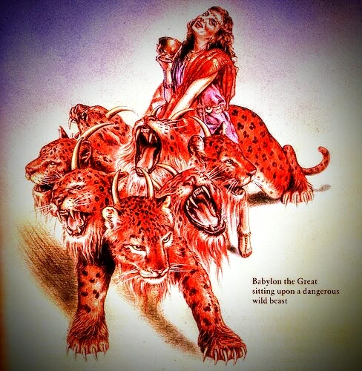
End of Babylon “the great” – Revelation Chapter 18
v. 2 …Babylon the great is fallen…
v. 21 …Thus with violence shall that great city Babylon be thrown down, and shall be found no more at all.

Slide 69
The Great City – Holy Jerusalem
Revelation 21:2,9,10
Will never be destroyed like the other great city (Babylon)
But, originates from God and will be established forever.

Slide 70
Blue Line Red Line
Old Testament
Israel People/Nation Babylon
Melchizedek Champion Nimrod
New Testament
Israel People/Nation Babylon
Jesus Christ Champion The Man of Sin
Notes:
Ben’s presentation time – 28-30+ mins.

Slide 71
Come out of her my people (Revelation 18:4)
And I heard another voice from heaven, saying, Come out of her, my people, that ye be not partakers of her sins, and that ye receive not of her plagues.
Who is the “her”? (v. 2)
Who are “my people”? (v. 4)
Can we be in “Babylon”? (2 Cor. 6:16-18)

Slide 72
THE FAMILY OF YAHWEH
- Two Seeds, Two Lines & Two Rival Systems

Slide 73
The Two Lines
El (God)
Elohim (multitude of mighty ones)
Fall
Seed of the Woman
Seed of Serpent
Abel (Gen.4:2-9)
Cain (Gen. 4:1-15)
Seth (Gen. 4:25, 5:4-8)
Sin & Death No More (Rev. 20:10; 21:4)
Notes:
Note that Eve names her first child; she had hoped he would be that promised seed. Of course, Cain proves to be the ‘seed of the serpent’ and not the ‘seed of the woman’ as he murders his brother and receives his own curse (4:11-14). Then note v. 25 – another son is born that she names Seth; and most interesting is fact that God hath appointed me another seed instead of Abel. Name “Seth” means “appointed”. And so, Eve named him Seth as she was still looking for that promised seed that was “appointed unto her” (Gen. 3:15). Seth would now become the beginning of that blue line that would continue on and one day would bring forth the promised seed “singular”. So, the blue line would continue through the descendants of Seth and those that would call upon the name of the. LORD. We are told of Enoch for example that he ‘walked with God’ (Gen. 5:22,24).

Slide 74
Blue Line Red Line
Old Testament
Israel People/Nation Babylon
Melchizedek Champion Nimrod
New Testament
Israel People/Nation Babylon
Jesus Christ Champion The Man of Sin
Notes:
Ben’s presentation time – 28-30+ mins.

Slide 75
Come out of her my people
Item | Rev. 18:4 | 2 Cor. 6:16-18 | Jer. 50:1-10
Who? | My people | My people | My people
Out of Whom? | Mystery Babylon the Great | Idol worshippers | Babylon
Command? | Come out | Come out | Remove out
Why? | Not partakers; receive not her plagues | To be His sons and daughters | For safety from coming destruction

Slide 76
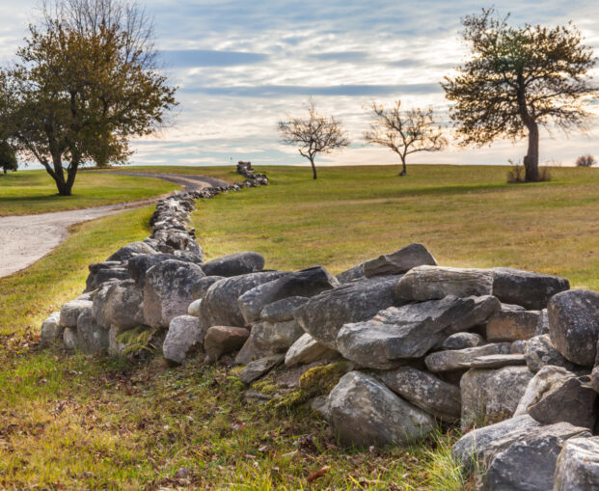
What does to “come out” mean; what does it involve ?
NOT the 21st century definition
Jeremiah 51:45 My people, go ye out of the midst of her, and deliver ye every man his soul from the fierce anger of the LORD.
2 Cor. 6:17 …be ye separate…and touch not the unclean thing and I will receive you.
“separate” – Greek “aphorizo” (Strong’s #873) - means “to set off by boundary, limit, exclude, etc.

Slide 77
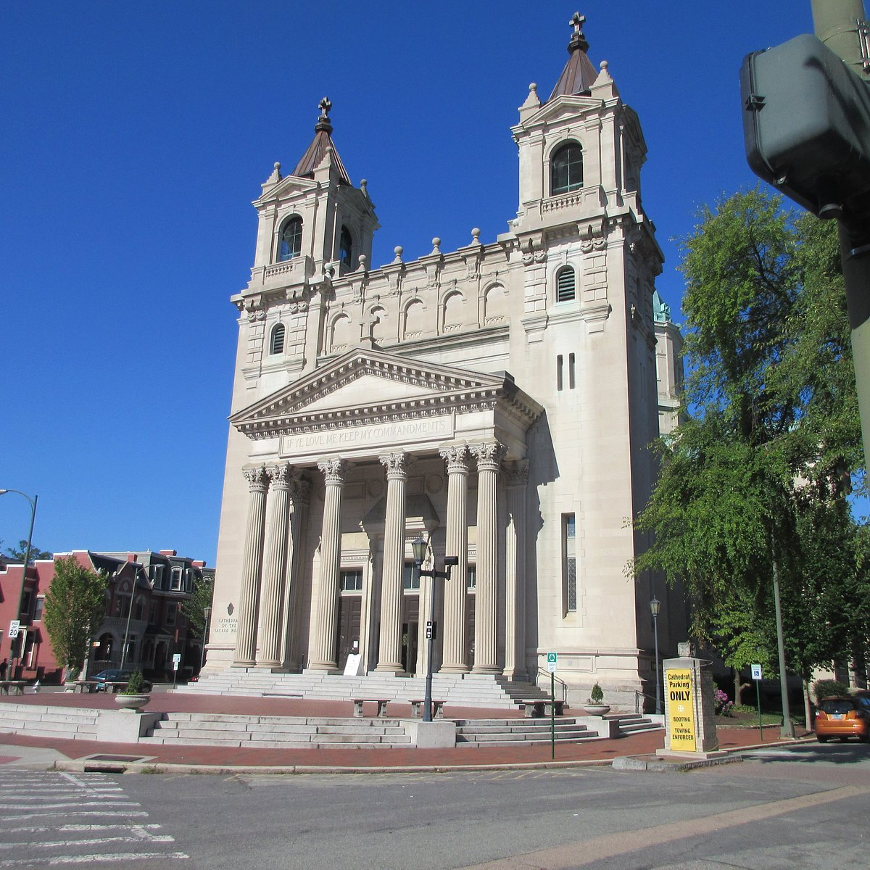
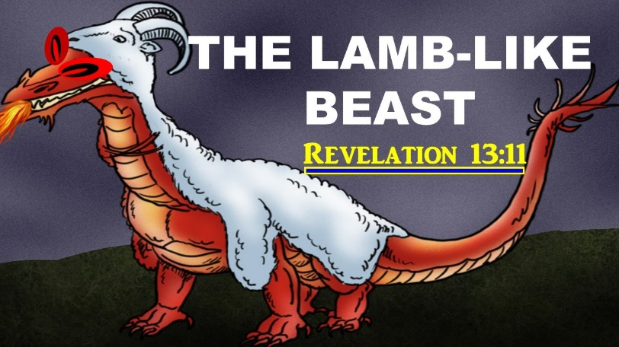
“Getting out” of Mystery Babylon

Slide 78
Spiritual Israel
Galatians 6:15-16 – Israel of God
Ephesians 2:12-13 – formerly aliens from the commonwealth of Israel…But now in Christ Jesus…are made nigh by the blood of Christ.
1 Peter 2:9-10 – But ye are a chosen generation…an holy nation, a peculiar people… now the people of God
Notes:
All that is represented in Babylon, the great rival system that has opposed Yahweh and all those that believe in Him will eventually come to an end, a final and ultimate destruction. But the Israel of God will never end. The Apostle Paul speaks often of Spiritual Israel in his letters to the ecclesias, as he compares it to Israel of the flesh. We also have the very familiar words of Peter when he describes spiritual Israel in his first epistle. Spiritual Israel will continue to exist and certainly not suffer the same fate as Babylon the Great but will be eternally blessed.

Slide 79
Genesis 9:20-24

Slide 80
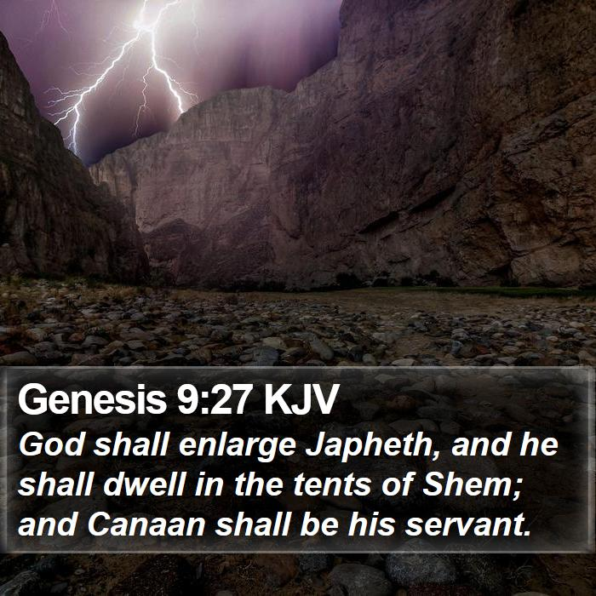
The Blessing/Cursing of Noah’s Sons (Genesis 9)
Blessing of Shem v. 26
Cursing of Canaan v. 25
Noah’s “Prophecy” v. 27
“Japheth [expansion] of Elohim [mighty ones] shall enlarge and dwell in the tents of Shem. ”
Notes:
Incident Shem, Ham and Japheth when Ham saw the nakedness of Noah but did not cover his father; telling his brothers, they went in and laid a garment upon Noah. As a result, Noah blessed Shem and Japheth but cursed Canaan, the son of Ham. Noah’s blessing of his two sons here is very significant. Abraham, father of the Hebrews, descended from Shem. Shem had a special relationship with the Most High. Of the 3 sons, God is directly associated with him alone. Yet, Noah declared that God would enlarge Japheth and he would dwell in the tents of Shem. What is the significance of Japheth dwelling in tents? If there is a spiritual significance, it implies that the Gentiles as the descendants of Japheth would eventually be destined to occupy a position equivalent to Shem. We should look at other references to dwelling in tents to try and better understand its significance as it does appear to relate to our subject of the family of God.

Slide 81
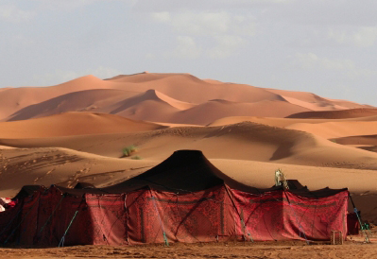
Dwelling in Tents
Abraham – Gen. 12:8
Isaac – Gen. 24:67
Jacob – Gen. 25:27
Notes:
Is the constant reference to dwelling in tents by Abraham and his descendants just incidental or is it a characteristic that is recorded by the Spirit to note something special about the patriarchs? Abraham chose a nomadic way of life as a tent-dweller as opposed to his nephew Lot who pitched his tent toward Sodom and soon moved into the city and acquired a house there. Abraham made a conscious decision to separate himself from the culture from which he came out of – Mesopotamia, the most advanced civilization of the ancient world. We also note a connection between pitching of tents and building of altars as an act of worship. This may be an indication of the spiritual significance of tent dwelling.

Slide 82
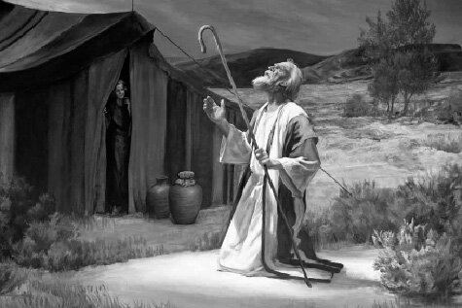
The Tent & Altar Connection
And (Abraham) …pitched his tent…and there builded an altar unto the LORD and called upon the name of the LORD. Gen. 12:8
And (Isaac) builded an altar there, and called upon the name of the LORD, and pitched his tent there… Gen. 26:25
And Jacob came to Shecem…and pitched his tent…And he erected there an altar and called it EleloheIsrael (God, the God of Israel). Gen. 33:18-20

Slide 83
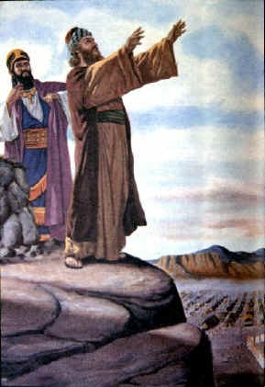
The Prophecy of Balaam
Numbers 24:6-7 (Septuagint)
How goodly are thy inhabitants, Jacob and thy tents, Israel! As shady groves, and as gardens by a river, and as tents which God pitched, and as cedars by the waters. There shall come a man out of his seed, and he shall rule over many nations…
Notes:
When Balaam overlooked the camp of Israel spread out in the valley below, he prophesied concerning the destiny of the nation. We find him praising the tents of Jacob and comparing them to the trees of the Lord’s planting. This prophecy most significantly connects the figure of the tents of Jacob with the multitude of the redeemed in whom the Most High will show forth His glory. Balaam foretold that one would come out of the seed of Jacob whose rule would extend over the Gentiles.

Slide 84
Abraham’s Tent-Dwelling Testified in the Book of Hebrews
By faith Abraham, when he was called to go out into a place which he should after receive for an inheritance, obeyed; and he went out, not knowing whither he went.
By faith he sojourned in the land of promise, as in a strange country, dwelling in tents with Isaac and Jacob, the heirs with him of the same promise: For he looked for a city which hath foundations, whose builder and maker is God. Hebrews 11:8-10
Notes:
This testimony explains the principle which compelled the patriarchs to live in tents and forsake the city-dwelling of the ancient world. Their tent-dwelling was a testimony to their faith in the promises. They would abide as sojourners, without putting down permanent roots, until the city of God’s building is established in the age of promise.

Slide 85
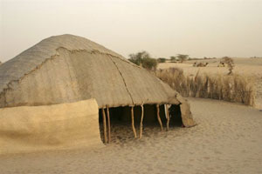
The Tents of Shem
Shem and the patriarchs which followed in his line are distinguished in Scripture as tent-dwellers. The line of promise (Blue Line) is marked off by the Spirit by genealogy but also by reference to their tents and altars built alongside.
They chose as a matter of principle to lead a nomadic life in keeping with their faith.
The tents of Shem are not a literal reference to actual canvas structures but stand for the faith of the men and women who dwelt in them.
Noah’s prophecy of Japheth dwelling in the tents of Shem is the first hint in Scripture that the Gentiles would be called “fellow-heirs of the promises,” embrace the faith of Abraham.

Slide 87
Jeremiah 35 – the Rechabites
Jonadab lived ~250 years before time of Jeremiah.
Group of Kenites, family of Rechab had taken temporary refuge from Babylonians in Jerusalem.
Faithful and obedient to instructions of Jonadab and the Nazarite vow.
Lived a simple tent life; separate from settled inhabitants of the land.
We will drink no wine: for Jonadab the son of Rechab our father commanded us, saying, Ye shall drink no wine, neither ye, nor your sons for ever: Neither shall ye build house, nor sow seed, nor plant vineyard, nor have any: (vv. 5-6)
but all your days ye shall dwell in tents; that ye may live many days in the land where ye be strangers. (v. 7)

Slide 88
Jeremiah 35:18-19
And Jeremiah said unto the house of the Rechabites, Thus saith the LORD of hosts, the God of Israel; Because ye have obeyed the commandment of Jonadab your father, and kept all his precepts, and done according unto all that he hath commanded you: Therefore thus saith the LORD of hosts, the God of Israel; Jonadab the son of Rechab shall not want a man to stand before me for ever.

Slide 89
Dwelling in Tents
Abraham – Gen. 12:8
Isaac – Gen. 24:67
Jacob – Gen. 25:27
Notes:
Yesterday, we examined what seems to be an important characteristic of the members of Yahweh’s family – that of being tent dwellers. Abraham, Isaac and Jacob we know to be tent dwellers as well as the Rechabites as we read in Jeremiah 35. Then we began to address the expansion of Yahweh’s family beyond natural Israel with the inclusion of the Gentiles.

Slide 90
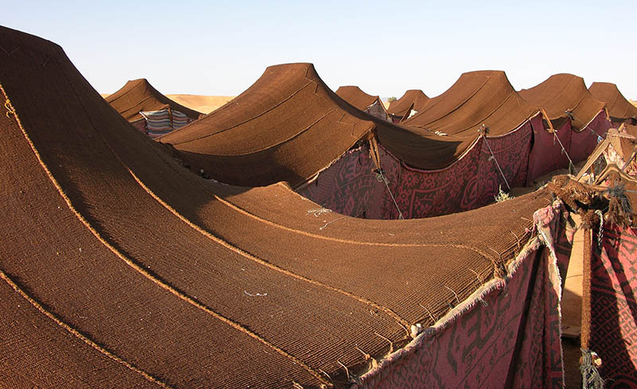
The Blessings/Curses of Noah’s Sons (Genesis 9)
Noah’s “Prophecy” v. 27
God shall enlarge Japheth, and he shall dwell in the tents of Shem; and Canaan shall be his servant.
Notes:
We looked closely at the very significant prophecy of Noah concerning his son Japheth – how he would dwell in the tents of Shem and not only that but he would be enlarged it says in Gen. 9:27. Bro. James pointed out another passage to me yesterday that not only speaks of the expansion of the tent but specifically mentions the Gentiles being involved in that expansion. Turn with me to Isaiah 54…

Slide 91
Isaiah 54:1-3
v. 1 – Barren and children of the desolate? (see Gal. 4:27)
v. 2 Enlarge the place of thy tent, stretch forth the curtains…lengthen thy cords and strengthen thy stakes
v. 3 …thy seed shall inherit the Gentiles.
Notes:
Read Isa. 54:1. Who is this barren one and who are the children of this desolate one? Paul tells us that it is Sarah and her seed are the children of promise in Gal. 4:27. But, let’s keep reading and see what the prophet reveals that is even more interesting [vv. 2-3]. We find this same metaphor as in the prophecy of Noah about the tent of Sarah’s children being enlarged – stretching forth the curtains, lengthening the cords and strengthening the stakes for whom – the Gentiles. Where else do we read about the expansion of God’s family to include the Gentiles?

Slide 92
Hosea 2:23
And I will sow her unto me in the earth; and I will have mercy upon her that had not obtained mercy; and I will say to them which were not my people, Thou art my people; and they shall say, Thou art my God.
Quoted from by Paul in Romans 9:24-26:
Even us, whom he hath called, not of the Jews only, but also of the Gentiles?
As he saith also in Osee, I will call them my people, which were not my people;…there shall they be called the children of the living God.
Notes:
This prophecy in Hosea foretold that those who were not originally the people of God would nevertheless come to be counted as His people and call Him their God. We might say that they are the remnant that would called from among the Gentiles as Paul clearly tells us when he quotes this prophesy in his letter to the Romans and more so, he says “there shall they be called the children of the living God” – a declaration that Gentiles would be part of His family. [go to page 49 in notes]

Slide 93
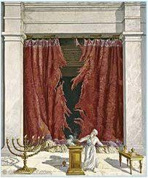
And he said, It is a light thing that thou shouldest be my servant to raise up the tribes of Jacob, and to restore the preserved of Israel: I will also give thee for a light to the Gentiles, that thou mayest be my salvation unto the end of the earth. Isaiah 49:6
And, behold, the veil of the temple was rent in twain from the top to the bottom; and the earth did quake, and the rocks rent. Matthew 27:51
Notes:
This prophecy of Isaiah proclaims that the salvation brought through Christ (as light unto the Gentiles) would extend beyond the tribes of Jacob and embrace the whole world including its Gentile inhabitants.

Slide 94
Isaiah 56:3-8
Neither let the son of the stranger, that hath joined himself to the Lord, speak, saying, The Lord hath utterly separated me from his people…
Also the sons of the stranger, that join themselves to the Lord, to serve him, and to love the name of the Lord, to be his servants, every one that keepeth the sabbath from polluting it, and taketh hold of my covenant;
Even them will I bring to my holy mountain, and make them joyful in my house of prayer: their burnt offerings and their sacrifices shall be accepted upon mine altar; for mine house shall be called an house of prayer for all people.
The Lord God, which gathereth the outcasts of Israel saith, Yet will I gather others to him, beside those that are gathered unto him.
Notes:
This is perhaps the most profound of the OT passages in terms of the extending of God’s family to non-Jews. Hopefully, the term “sons of the stranger” rings a bell as the theme of the Advocate’s current feature article series that has been running since the end of last year. Isaiah 56 has served as the theme passage for the series. It is definitely an uplifting and powerful message that was delivered by the prophet Isaiah. The term ‘stranger’ is used frequently in Scripture, particularly OT to describe anyone who is not a natural Israelite – a foreigner to the nation of Israel. Generally speaking the Jews were not to associate the strangers in the land. And they were certainly not to intermarry with those of the Gentiles that were to have been driven out of the Promised Land. We do know that there were a number of Gentiles that left Egypt with the children of Israel and sojourned with them as part of the ‘mixed multitude’. The Law of Moses provided for strangers to become as Israelites as long as they met certain conditions. Here in Isaiah we find confirmation of this – that sons of the stranger that join themselves to Yahweh to serve Him, love His name, keep the Sabbath and most importantly, take hold of the covenant – the everlasting covenant made unto Abraham. They would be ‘gathered’ unto the Lord God along with the outcasts of natural Israel and one day (we pray soon) will be brought to His holy mountain and made joyful in His house of prayer.

Slide 95
Isaiah 56:3-8
Neither let the son of the stranger, that hath joined himself to the Lord, speak, saying, The Lord hath utterly separated me from his people…
Also the sons of the stranger, that join themselves to the Lord, to serve him, and to love the name of the Lord, to be his servants, every one that keepeth the sabbath from polluting it, and taketh hold of my covenant;
Even them will I bring to my holy mountain, and make them joyful in my house of prayer: their burnt offerings and their sacrifices shall be accepted upon mine altar; for mine house shall be called an house of prayer for all people.
The Lord God, which gathereth the outcasts of Israel saith, Yet will I gather others to him, beside those that are gathered unto him.
Notes:
This is perhaps the most profound of the OT passages in terms of the extending of God’s family to non-Jews. Hopefully, the term “sons of the stranger” rings a bell as the theme of the Advocate’s current feature article series that has been running since the end of last year. Isaiah 56 has served as the theme passage for the series. It is definitely an uplifting and powerful message that was delivered by the prophet Isaiah. The term ‘stranger’ is used frequently in Scripture, particularly OT to describe anyone who is not a natural Israelite – a foreigner to the nation of Israel. Generally speaking the Jews were not to associate the strangers in the land. And they were certainly not to intermarry with those of the Gentiles that were to have been driven out of the Promised Land. We do know that there were a number of Gentiles that left Egypt with the children of Israel and sojourned with them as part of the ‘mixed multitude’. The Law of Moses provided for strangers to become as Israelites as long as they met certain conditions. Here in Isaiah we find confirmation of this – that sons of the stranger that join themselves to Yahweh to serve Him, love His name, keep the Sabbath and most importantly, take hold of the covenant – the everlasting covenant made unto Abraham. They would be ‘gathered’ unto the Lord God along with the outcasts of natural Israel and one day (we pray soon) will be brought to His holy mountain and made joyful in His house of prayer.

Slide 96
Isaiah 56:3-8
Neither let the son of the stranger, that hath joined himself to the Lord, speak, saying, The Lord hath utterly separated me from his people…
Also the sons of the stranger, that join themselves to the Lord, to serve him, and to love the name of the Lord, to be his servants, every one that keepeth the sabbath from polluting it, and taketh hold of my covenant;
Even them will I bring to my holy mountain, and make them joyful in my house of prayer: their burnt offerings and their sacrifices shall be accepted upon mine altar; for mine house shall be called an house of prayer for all people.
The Lord God, which gathereth the outcasts of Israel saith, Yet will I gather others to him, beside those that are gathered unto him.
Notes:
This is perhaps the most profound of the OT passages in terms of the extending of God’s family to non-Jews. Hopefully, the term “sons of the stranger” rings a bell as the theme of the Advocate’s current feature article series that has been running since the end of last year. Isaiah 56 has served as the theme passage for the series. It is definitely an uplifting and powerful message that was delivered by the prophet Isaiah. The term ‘stranger’ is used frequently in Scripture, particularly OT to describe anyone who is not a natural Israelite – a foreigner to the nation of Israel. Generally speaking the Jews were not to associate the strangers in the land. And they were certainly not to intermarry with those of the Gentiles that were to have been driven out of the Promised Land. We do know that there were a number of Gentiles that left Egypt with the children of Israel and sojourned with them as part of the ‘mixed multitude’. The Law of Moses provided for strangers to become as Israelites as long as they met certain conditions. Here in Isaiah we find confirmation of this – that sons of the stranger that join themselves to Yahweh to serve Him, love His name, keep the Sabbath and most importantly, take hold of the covenant – the everlasting covenant made unto Abraham. They would be ‘gathered’ unto the Lord God along with the outcasts of natural Israel and one day (we pray soon) will be brought to His holy mountain and made joyful in His house of prayer.

Slide 97
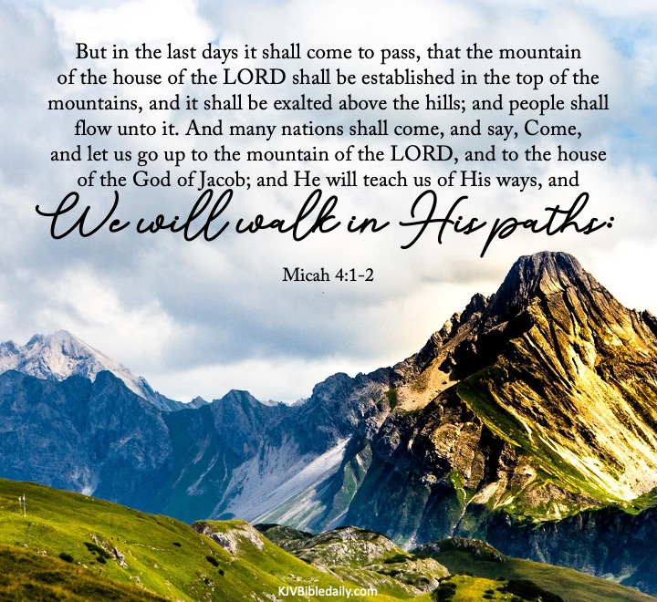

Slide 98
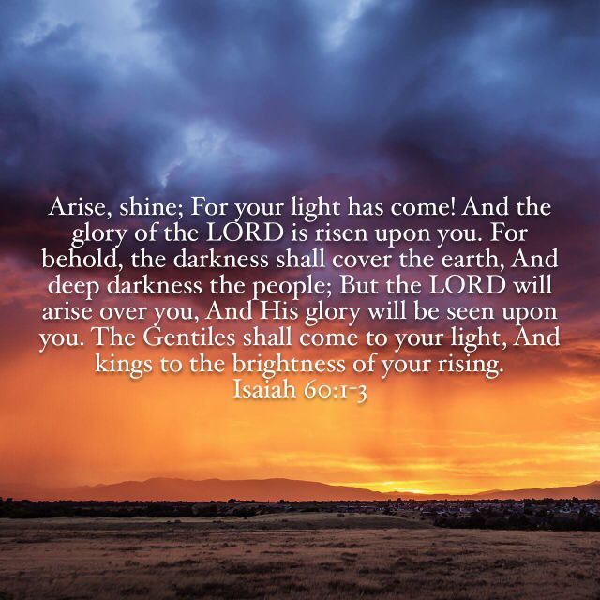
Notes:
Here we find another prophecy of Isaiah were he refers to Christ as the giver of light unto the Gentiles. In verse 1 of chapter 60, it speaks of the time of the restoration of Israel, when their ‘light’ would come. And the glory of Yahweh would rise upon them. Their time of blessing would arise with the coming of their Messiah. “And the Gentiles would then come to their light” - the light that would be manifest through their Messiah. He indeed has enlightened the darkness of the Gentiles even now.

Slide 99
THE BLESSING OF THE GENTILES IN THE MILLENNIAL AGE
How many will remain on the earth?
Gentile mortals - same opportunity to obtain blessing through the Promised Seed as do Jews who recognize and accept their Messiah.
Zechariah 14:16
Revelation 14:6-7

Slide 100
Four Phases of the Calling of the Gentiles
Before Abraham – God’s purpose with the Gentiles foreshadowed in the blessing which Noah pronounced on Shem.
Abraham to Christ – His purpose worked out through the people of Israel and such Gentiles as chose to join the nation and take hold of the covenant.
Christ to the Millennium – God’s call extended to all Gentiles through sacrifice of Christ and work of the apostles.
During the Millennium – Gentile mortals will be subjects of the Kingdom and potential converts.

Slide 101
The Restoration of Israel
Thus saith the LORD; Behold I will bring again the captivity of Jacob’s tents, and have mercy on his dwellingplaces…And out of them shall proceed thanksgiving…
and I will multiply them and they shall not be few…At the same time, saith the LORD, will I be the God of all families of Israel,
and they shall be my people…The LORD hath appeared of old unto me, saying, yea, I have loved thee with an everlasting love. Jeremiah 30:18,19; 31:1,3
Notes:
‘to bring again the captivity’, a phrase that occurs often in KJV, means to turn the captivity (to and end). RSV – to restore the fortunes. Jacob’s tents – symbol for those who hold the faith of the fathers. why does the prophet refer to God as of all families of Israel? Does it not sound like the words of Paul when he declared All Israel shall be saved? – Both the natural and the wild branches of the olive tree (Jews and believing Gentiles).

Slide 102
The Eternal Family of Yahweh
As Revealed in the Elohim
and His Memorial Name

Slide 103
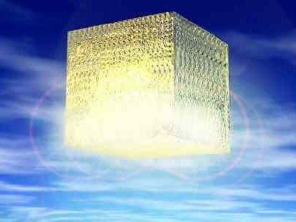
New Jerusalem and the Bride Adorned for Her Husband
And I John saw the holy city, new Jerusalem, coming down from God out of heaven, prepared as a bride adorned for her husband.
3 And I heard a great voice out of heaven saying, Behold, the tabernacle of God is with men, and he will dwell with them, and they shall be his people, and God himself shall be with them, and be their God. Revelation 21:2-3
Notes:
What is very interesting if not most remarkable is where we find the other reference to God dwelling with His people and His tabernacle being with men – ‘that they shall be his people and He will be their God’. And what is particularly uplifting that it is in the context of marriage – ‘the holy city, the new Jerusalem, prepared as a bride adorned for her husband’.

Slide 104
The Husband Relationship with Natural Israel
Fear not; for thou shalt not be ashamed: neither be thou confounded; for thou shalt not be put to shame: for thou shalt forget the shame of thy youth, and shalt not remember the reproach of thy widowhood any more.
For thy Maker is thine husband; the Lord of hosts is his name; and thy Redeemer the Holy One of Israel; The God of the whole earth shall he be called.
For the Lord hath called thee as a woman forsaken and grieved in spirit, and a wife of youth, when thou wast refused, saith thy God. Isaiah 54:4-6

Slide 105
Faithful Relationship

Slide 106
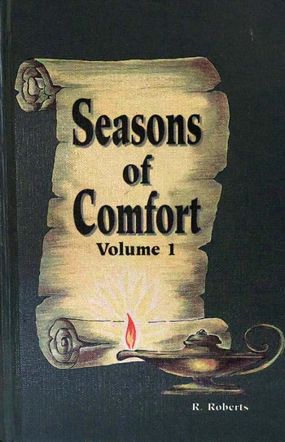
The Marriage Supper of the Lamb pp. 432-437

Slide 107
Stages leading to Marriage – A Pattern of the Bride of Christ
Stage 1: Acquaintance
But he that received seed into the good ground is he that heareth the word (of Christ and the kingdom) and understandeth it. Matt. 13:23
Stage 2: Love
That Christ may dwell in your hearts by faith; that ye may be rooted and grounded in love, and may be able to comprehend with all saints what is the breadth, and length, and depth, and height; and to know the love of Christ, which passeth knowledge, that ye might be filled with the fullness of God. Eph. 3:17-19

Slide 108
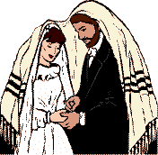
Stages leading to Marriage – A Pattern of the Bride of Christ
Stage 3: Betrothal
“I have espoused you to one husband, that I may present you as a chaste virgin to Christ.” 2 Cor. 11:2
“[God] shall call to the heavens from above, and to the earth, that he may judge his people. Gather my saints together unto me: those that have made a covenant with me by sacrifice” . Psa. 50:4-5

Slide 109
Questions
“How have we fulfilled our end of the covenant?”
Have we sustained the part of the chaste virgin?
Have we made ourselves ready to be presented as the bride to the bridegroom?
Have our affections been fixed upon Jesus, as our coming husband?
Have we been as devoted to his affairs as he would have us be?
Have we been as tender and loving towards him as he expects?

Slide 110
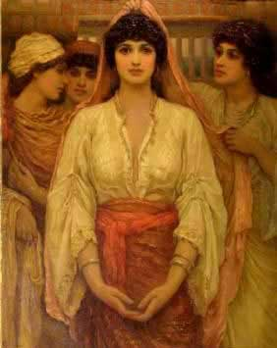
4: Fulfilment of the Covenant– Sonship and Daughtership
“and I will receive you… and ye shall be my sons and daughters. 2 Cor. 6:17-18
“He that overcometh shall inherit all things; and I will be his God, and he shall be my son” . Rev. 21:7
“I will write upon him my new name”. Rev. 3:12

Slide 111
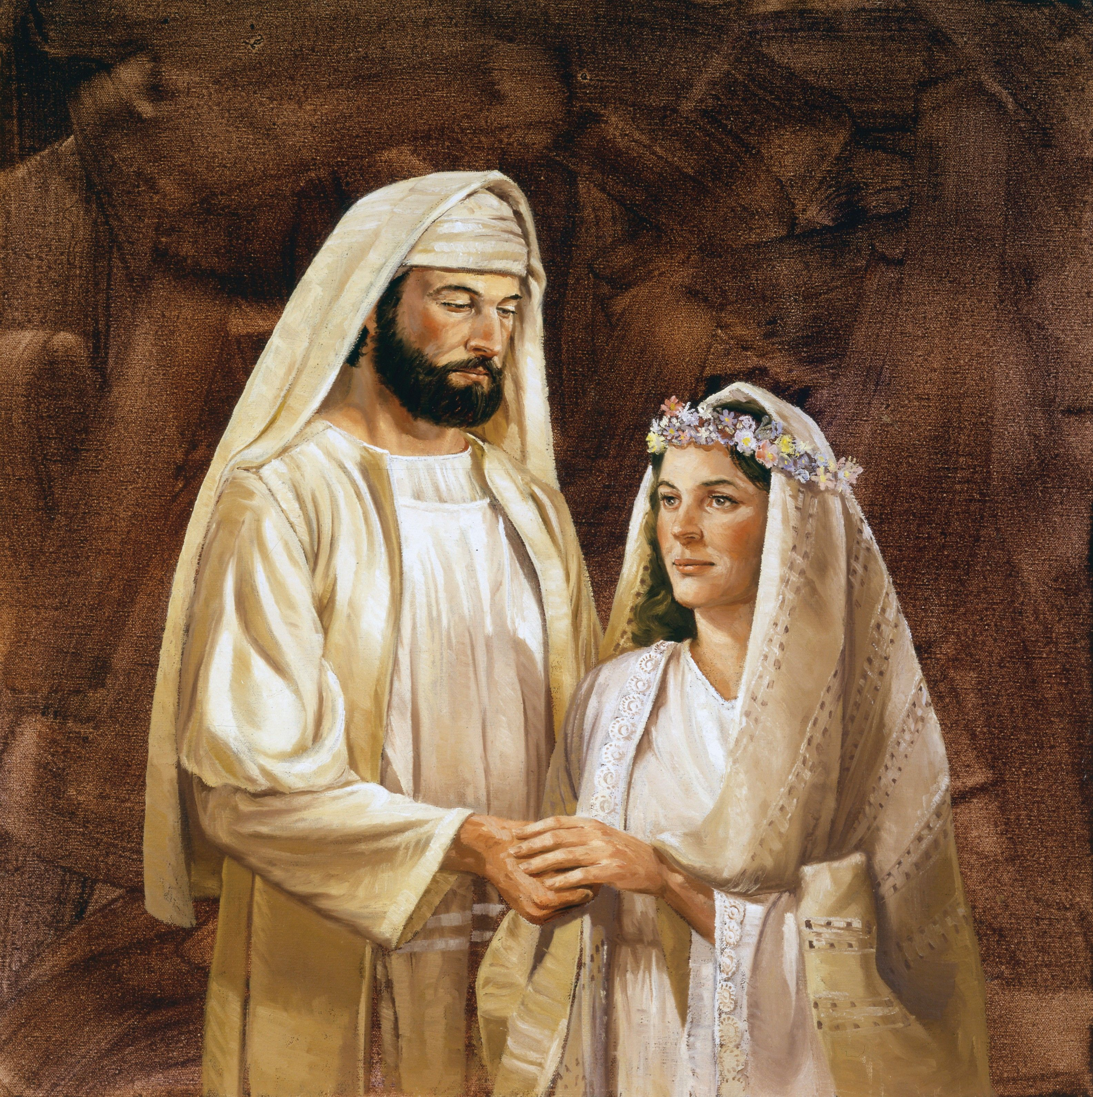
Final Stage: Marriage
Betrothal ends in glorious marriage - Rev. 19:1-3
Hallelujah: for the Lord God omnipotent reigneth. Let us be glad and rejoice, and give honour to him: for the marriage of the Lamb is come, and his wife hath made herself ready. Rev. 19: 6, 7

Slide 112
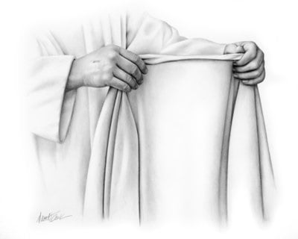
Fine Linen = Righteousness of Saints
And to her was granted that she should be arrayed in fine linen, clean and white: for the fine line is the righteousness of the saints. Rev. 19:8

Slide 113
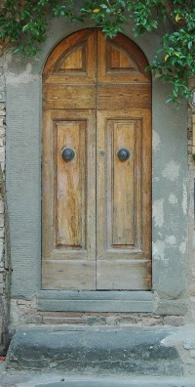
“Behold, I stand at the DOOR, and knock; if any man hear my voice, and open the DOOR, I will come into him, and will SUP with him, and he with me” Rev. 3:20
“For as often as you eat this bread and drink this cup, ye do shew the Lord’s death till he come”
Past
Present
Future

Slide 114
Revelation 7

Slide 115
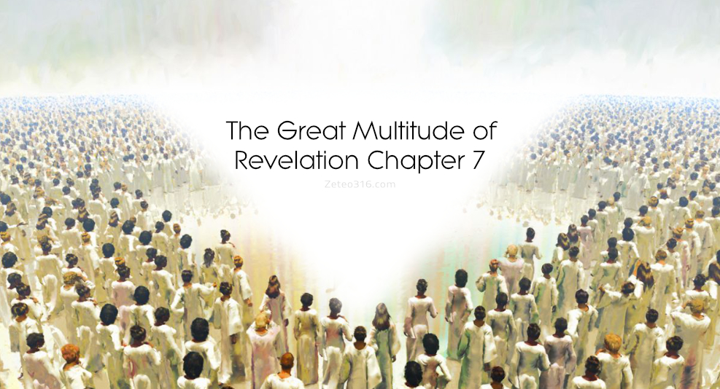

Slide 116
The Elohim In Heaven And Earth
In the ultimate purpose of God, the Elohim of heaven, and the Elohim of earth will be bound together into one family, united by common lineage of descent through one Father of our Lord Jesus Christ. See Ephesians 3:14-21.
The sequence:
the Father
Abraham
the Lord Jesus Christ
Isaac
the whole family
Jacob

Slide 117
The Divine Purpose In God’s Prophetic/Memorial Name
ehyeh
asher
ehyeh
first person verb,
singular,
imperfect (future)
singular and plural,
masculine and
feminine
first person verb,
singular,
imperfect (future)
I will be
who
(in a multitude)
I will be

Slide 118
My Name And My Memorial
Exodus 3:15 – “this is my name… this is my memorial”
‘Name’ and ‘Memorial’ are parallel terms in the passage. The name of Yahweh is a memorial of His character, His intention and His purpose.
Memorial – zeker from zakar – to mark so as to recognise. Who is interested in preserving a family name? The Father who bears the name, and then His offspring. These are those who have marked that name so as to recognise it.

Slide 119
Cutting Off of Two Parts
Awake, O sword, against my shepherd, and against the man that is my fellow, saith the Lord of hosts: smite the shepherd, and the sheep shall be scattered: and I will turn mine hand upon the little ones.
And it shall come to pass, that in all the land, saith the Lord, two parts therein shall be cut off and die; but the third shall be left therein.
And I will bring the third part through the fire, and will refine them as silver is refined, and will try them as gold is tried: they shall call on my name, and I will hear them: I will say, It is my people: and they shall say, The Lord is my God. Zech. 13:7-9
Notes:
Verse 7 is quoted in Matt. 26: 31 and John 16:32 re: when the disciples were scattered in the Garden of Gethsemane on the night before our Lord’s cruxifiction. Awake, O sword, against my shepherd, and against the man that is my fellow, saith the Lord of hosts: smite the shepherd, and the sheep shall be scattered: and I will turn mine hand upon the little ones.
8 And it shall come to pass, that in all the land, saith the Lord, two parts therein shall be cut off and die; but the third shall be left therein.
9 And I will bring the third part through the fire, and will refine them as silver is refined, and will try them as gold is tried: they shall call on my name, and I will hear them: I will say, It is my people: and they shall say, The Lord is my God. evening before the crucifixion. 2nd part of this prophecy deals with the time when the Almighty will accept Israel again as His people. It awaits the completion of the restoration process that is already well in hand, when the nation through Christ is introduced to the new covenant. Cutting off of the 2 parts must therefore occur sometime between 33 AD (death of Christ) and future conversion of the nation after his return. Does it refer to AD 70 when over 1 million Jews perished or to a time yet future?

Slide 120
Social Connections
Jobs/Employment
Neighbors
School friends
Sports
Hobbies
Clubs and associations
Charities/organizations
Churches/Religious affiliations

Slide 122
Who would have thought…
Russia set up base in Syria
Brexit
New Administration
Russia – US political connections
Dramatic changes in Turkey
US involvement in Syria
Rising tension between the 2 great super-powers
Rampant acts of terrorism & anti-Semitism
Where Arab Spring has led - Tighter Arab nation alignment between pro-Israel/pro-Western & anti-Israel/pro-Russia

Slide 123
The Son Appointed As Heir Only
After Probation
Genesis 21:10, 24:36, 25:5 - Isaac from an early age was counted as ‘the heir’ of his Father’s house. However, it was only after his faithful obedience unto sacrificial death, that his father did indeed give him ‘all that he had’.
Philippians 2:8-11, Hebrews 1:1-5 - The exaltation of Christ was similarly the response of his Father to his willing obedience even unto death, in humble submission. This Son of his Father was granted an inheritance after being offered in the mount. It was the good pleasure of God to make his son ‘the heir of all things’.

Slide 124
The Obedient Son And The
Anguished Father
Genesis 22:2, Matthew 3:17,17:5 - Isaac is described as ‘thy son, the beloved one’. (LXX) He foreshadows the Lord who was described by his Father as ‘my beloved son’ at both his baptism and transfiguration.
Genesis 22:6-9, John 8:29, 16:32, 1 Peter 2:22-23 - The co-operation of Isaac in loving submission to his Father’s will, was complete and entire, as the perfect unresisting sacrifice.
Genesis 22:12, 16, Romans 8:31-32 - Abraham was invited to enter into the love and anguish of God, in experiencing the emotion of ‘not sparing his own son’.

Slide 125
Yahweh Elohim, The Elohim Of Abraham, Isaac and Jacob
God entitles Himself - Yahweh Elohim of your fathers, the Elohim of Abraham, the Elohim of Isaac, and the Elohim of Jacob.
Yahweh’s purpose to manifest Himself is revealed in the names and lives of the three patriarchs. Together these three form a prophecy of Yahweh’s intention to be revealed as a Father (Abraham), declared in a Son (Isaac), and proclaimed through a Multitude (Jacob).
These names were chosen to represent the memorial of His proposed manifestation in flesh, and to identify his selection of the family through whom such mighty ones of the future would be established.

Slide 126
By My Name Yahweh Was I
Not Known Unto Them?
Exodus 6:3 – The Divine Name was known unto the three patriarchs, for they used it in understanding:
Abraham
Genesis 15:2,8 Yahweh, Adonai Yahweh
Genesis 22:13-14 Yahweh Yireh
Genesis 24:3,7 Yahweh Elohim
Isaac
Genesis 27:27-28 Yahweh Elohim
Jacob
Genesis 49:18 Yahweh

Slide 127
Genesis 1:26-28
And God said, Let us make man in our image, after our likeness: and let them have dominion over the fish of the sea, and over the fowl of the air, and over the cattle, and over all the earth, and over every creeping thing that creepeth upon the earth.
So God created man in his own image, in the image of God created he him; male and female created he them.
And God blessed them, and God said unto them, Be fruitful, and multiply, and replenish the earth, and subdue it: and have dominion over the fish of the sea, and over the fowl of the air, and over every living thing that moveth upon the earth.

Slide 128
Yahweh Elohim, The Elohim Of Abraham, Isaac and Jacob
God entitles Himself - Yahweh Elohim of your fathers, the Elohim of Abraham, the Elohim of Isaac, and the Elohim of Jacob.
Yahweh’s purpose was to reveal Himself in the names and lives of the three patriarchs. Together these three form a prophecy of Yahweh’s intention to be revealed as a Father (Abraham), declared in a Son (Isaac), and proclaimed through a Multitude (Jacob).
This Name was given to identify His selection of the family through whom the Elohim or “mighty ones” of the future would be established. Those who are called out and chosen must know this Name and live by it.

Slide 129
Yahweh Elohim, The Elohim Of Abraham, Isaac and Jacob
God entitles Himself - Yahweh Elohim of your fathers, the Elohim of Abraham, the Elohim of Isaac, and the Elohim of Jacob.
Yahweh’s purpose was to reveal Himself in the names and lives of the three patriarchs. Together these three form a prophecy of Yahweh’s intention to be revealed as a Father (Abraham), declared in a Son (Isaac), and proclaimed through a Multitude (Jacob).
This Name was given to identify His selection of the family through whom the Elohim or “mighty ones” of the future would be established. Those who are called out and chosen must know this Name and live by it.

Slide 130
Lessons From The Father’s House
Eliezer
Genesis 17:23-27,18:19 - Abraham as a teaching father was famous for instilling his family values in his children, and in all servants of his household.
Genesis 14:14, 15:2, 24:12, 21, 26-27 - All the servants of his household were instructed in his ways, of whom Eliezer was the exemplar and epitome.
Genesis 24:2,10, Luke 12:41-44, 1 Peter 4:10 - His service showed absolute devotion to the cause of the master and heir, the father and son of the household.
Servants who love and uphold the father’s family principles will be accepted.
Notes:
130

Slide 131
The Key To The Baptismal Code
Matthew 28:19 – “ Baptizing them in the name of the Father, and of the Son, and of the Holy Spirit”.
The principle of the Elohim of Abraham, Isaac and Jacob is the key to the interpretation of the baptismal code:
Abraham = the Father Yahweh
Isaac = the Son Christ
Jacob = the Multitude Holy Spirit
Baptism relates to the work of salvation which God has accomplished through the sacrificial death of His Son, which is extended to the multitudinous seed through the power of the Holy Spirit in empowering the spread of the gospel to all nations.

Slide 132
The Multitudinous Seed To Include
The Gentiles
John 21:6,11 - The ‘gospel net’ was to be cast by the apostles into the ‘sea of nations’. The 153 fish symbolise the multitudinous seed taken from both Jew and Gentile.
The phrase ‘beni ha Elohim’ = the sons of God, symbolising the multitude of the redeemed has a numerical value in Hebrew of 153.
Genesis 48:4-5,16 - The symbol of the fish as the multitudinous seed is based upon this word of Jacob.

Slide 133
Framework of Bible Prophecy
Yahweh’s memorial & prophetic Name
His Purpose for this Creation
His Promises & Covenants
The First Promise & The Two Seeds

Slide 134
Blue Line Red Line
Phase I Old Testament Phase I
The Book of Daniel
Israel vs. Babylon
Phase II New Testament Phase II
The Book of Revelation
The Saints vs. Rome
(Spiritual Israel) (Babylon Phase II)
Notes:
Ben’s Part 2 – 23-25 mins.

Slide 135
The New Covenant & Israel’s Restoration
Behold, the days come, saith the Lord, that I will make a new covenant with the house of Israel, and with the house of Judah:
³² Not according to the covenant that I made with their fathers in the day that I took them by the hand to bring them out of the land of Egypt; which my covenant they brake, although I was an husband unto them, saith the Lord:
³³ But this shall be the covenant that I will make with the house of Israel; After those days, saith the Lord, I will put my law in their inward parts, and write it in their hearts; and will be their God, and they shall be my people.
³⁴ And they shall teach no more every man his neighbour, and every man his brother, saying, Know the Lord: for they shall all know me, from the least of them unto the greatest of them, saith the Lord: for I will forgive their iniquity, and I will remember their sin no more. Jeremiah 31:31-34

Slide 136
The Tents of Israel Restored
Sing, O barren, thou that didst not bear; break forth into singing, and cry aloud, thou that didst not travail with child: for more are the children of the desolate than the children of the married wife, saith the Lord. [Quoted in Galatians 4:27]
Enlarge the place of thy tent, and let them stretch forth the curtains of thine habitations: spare not, lengthen thy cords, and strengthen thy stakes;
For thou shalt break forth on the right hand and on the left; and thy seed shall inherit the Gentiles, and make the desolate cities to be inhabited. Isaiah 54:1-3
*
Notes:
In this prophecy of Isaiah, Israel’s restoration is depicted by reference again to the figure of tents being pitched and expanded. This literally happened in the early days of the Jews returning to the land due to the large influx of immigrants, especially the very large numbers of Soviet Jews. They had to live temporarily in tent cities similar to the ones that the Syrian refugees have been living in recently. In the higher spiritual sense, the tents again represent the faith of Abraham and those that hold to it – pointing forward to the coming conversion of the nation and the blessing under the new and everlasting covenant.

Slide 137
Sequence of the Restoration
Return of the Jews to the Promised Land
Cleansing of the land of its abominations (mosques, churches, etc.)
Forgiveness of nation accompanied by a change in Israel’s spirituality and obedience
Truly becoming God’s people again – connected to the Everlasting Covenant

Slide 138
The Parable of the Nation
Adam
Israel
Fell and as expelled from paradise.
Placed under an onerous curse that affected all of his seed.
Was offered a way back to the tree of life through the sacrifice of the Lamb.
Was unworthy of the grace revealed.
Disobeyed, broke God’s covenant and was driven from the land
Was cursed in the Law for all of its generations.
Offered restoration through the blood of the Lamb.
Also unworthy of the favor shown unto it by Yahweh.

Slide 139
The Message of Romans Chapter 11
Key Points:
When God’s favor was turned away from Israel as a nation, His mercy was still extended to them as individuals. Even so then at this present time also there is a remnant according to the election of grace. (v. 5)
By their fall, the Gentiles received benefit, namely the riches of the glory of this mystery…but now is made manifest to the saints (Col. 1:26-27).
…through their fall salvation is come unto the Gentiles (v. 11)

Slide 140
The Message of Romans Chapter 11
Key Points (cont’d):
3. If the Gentiles received benefit from the temporary casting away of Israel, an even greater benefit for the Gentiles will be associated with their restoration to Divine favor (i.e., resurrection). How much more their fullness? …what shall the receiving of them be, but life from the dead. (vv. 12,15)
4. Analogy of Olive Tree: Natural branches cut off; wild branches grafted in. But, natural branches to be grafted in again. (vv. 23-24)
5. Casting away – interim arrangement; then “all Israel” will be saved. (vv. 25-27)

Slide 141
Israel Comes Full-Circle (Romans 11)
Blue Line
Natural Israel
Work of Christ (Matt. 24 – AD 70)
Spiritual Israel
Natural Israel Restored

Slide 142
The Restoration of Israel

Slide 143
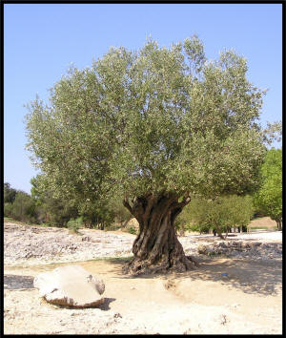
The Olive Tree
NATURAL BRANCHES
WILD BRANCHES
Some broken off due to unbelief
May be grafted in again on basis of abiding still not in unbelief
Much more readily grafted in
Natural branches = Israel
Breaking off = fall of Israel
Grafted on to partake of its holy root & fatness
Stands by faith & continuance in goodness of God
Contrary to nature
Wild branches = Gentiles
Grafting in = Adoption of Gentiles through faith

Slide 145
Why must Israel be fully restored?
Therefore say unto the house of Israel, thus saith the Lord God; I do not this for your sakes, O house of Israel, but for mine holy name's sake…
And I will sanctify my great name, which was profaned among the heathen,… when I shall be sanctified in you before their eyes. For I will take you from among the heathen, and gather you out of all countries, and will bring you into your own land...A new heart also will I give you, and a new spirit will I put within you: and I will take away the stony heart out of your flesh, and I will give you an heart of flesh.
And I will put my spirit within you, and cause you to walk in my statutes, and ye shall keep my judgments, and do them.
And ye shall dwell in the land that I gave to your fathers; and ye shall be my people, and I will be your God.
Ezekiel 36:22-28
Notes:
Not for their sakes but for God’s holy name’s sake. We know that the Name describes the divine purpose to reveal His glory in the multitude of the Abrahamic faith. The restoration of Israel has been accomplished to prepare for the glorification of the resurrected seed of Abraham!

Slide 146
Reason No. 2 – The Everlasting Covenant
Moreover I will make a covenant of peace with them; it shall be an everlasting covenant with them: and I will place them, and multiply them, and will set my sanctuary in the midst of them for evermore.
My tabernacle also shall be with them: yea, I will be their God, and they shall be my people.
And the heathen shall know that I the Lord do sanctify Israel, when my sanctuary shall be in the midst of them for evermore. Ezekiel 37:26-28
Notes:
God will make His everlasting covenant with them and will set His sanctuary in their midst. At that point, they will again be described as “His people”. And the Gentile nations will come to recognize the hand of God in Israel’s restoration. They will be sanctified and once again be an “Holy People”.

Slide 147
The Israel of God
Where do the Gentiles enter the picture?
Simeon hath declared how God at the first did visit the Gentiles, to take out of them a people for his name. And to this agree the words of the prophets; as it is written…(Acts 15:14-15)
What prophets and where in the OT Scriptures is this written?

Slide 148
The Husband Relationship – broken, but to be restored
Not according to the covenant that I made with their fathers in the day that I took them by the hand to bring them out of the land of Egypt; which my covenant they brake, although I was an husband unto them, saith the Lord. Jeremiah 31:32
Turn, O backsliding children, saith the Lord; for I am married unto you: and I will take you one of a city, and two of a family, and I will bring you to Zion: Jeremiah 3:14
Notes:
Why is this figure of husband to wife especially poignant to describe the relationship of God to His people?

Slide 149
Progression of the Red Line – Spiritual Babylon
Natural Israel
Work of Christ (Matt. 24 – AD 70)
Spiritual Israel
(Galatians 6)
Natural Israel Restored
(Romans 11)
Natural Babylon
Pergamos (Rev. 2:13)
Rome - Babylon Phase 2 (Dan. 8:9)
Spiritual Babylon
(Dan. 7:8; Rev.1 7:3-6;
Rev. 20:1-3,7-10)

Slide 150
Key Prophecies – Daniel & Revelation
Daniel – Phase 1
Apostle John – Phase 2
Age – 85-90 years old
Received while in Exile in Babylon
“O Man greatly beloved” (Dan. 10:19)
Figurative Death & Resurrection (10:8-20)
Emotionally involved in his prophecy (7:15, 8:27, 10:19)
Age – 90+ years old
Received in Exile on Isle of Patmos (Babylon Phase 2)
Disciple whom Jesus loved
Figurative Death & Resurrection (Rev. 1:17-18)
Emotionally involved as well (Rev. 5:4)

Slide 151
The Two Seeds, Two Lines & Two Ways of Thinking
Genesis 3:13-15

Slide 152
The Two Seeds - An Allegory
Blue Line
Red Line
Seed of the Woman
Seed of Serpent
Children of the Kingdom (good seed in Matt. 13))
Children of the Wicked One (tares in Matt. 13)
Servants of Righteousness (Rom. 6:18)
Servants of Sin
(Rom. 6:17)
Notes:
Note that Eve names her first child; she had hoped he would be that promised seed. Of course, Cain proves to be the ‘seed of the serpent’ and not the ‘seed of the woman’ as he murders his brother and receives his own curse (4:11-14). Then note v. 25 – another son is born that she names Seth; and most interesting is fact that God hath appointed me another seed instead of Abel. Name “Seth” means “appointed”. And so, Eve named him Seth as she was still looking for that promised seed that was “appointed unto her” (Gen. 3:15). Seth would now become the beginning of that blue line that would continue on and one day would bring forth the promised seed “singular”. So, the blue line would continue through the descendants of Seth and those that would call upon the name of the. LORD. We are told of Enoch for example that he ‘walked with God’ (Gen. 5:22,24).

Slide 153
The Two Seeds
“The seed of the Serpent and the seed of the woman are phrases to be taken in the singular and in plural numbers. “
Red Line – “the mood of thinking elicited in Eve and her husband that was against My law”
Blue Line – “those of My institution who shall serve Me; their chief shall bear away the world’s sin and shall destroy all the works that have grown out of it.”
John Thomas, Elpis Israel, p. 111

Slide 154
From Eden to Eden: Parallels between Genesis & Revelation
Genesis
Revelation
Marriage of 1st Adam (2:21-24)
Loosening of serpent (3:1)
Sorrow of death introduced (3:19)
Way to tree of life barred (3:24)
Marriage of last Adam (19:7-9)
Binding of serpent that deceives (20:1-3)
Sorrow of death finally removed (21:4)
Way to tree of life opened (22:14)

Slide 155
Come out of her my people
Item | Rev. 18:4 | 2 Cor. 6:16-18 | Jer. 50:1-10
Who? | My people | My people | My people
Out of Whom? | Mystery Babylon the Great | Idol worshippers | Babylon
Command? | Come out | Come out | Remove out
Why? | Not partakers; receive not her plagues | To be His sons and daughters | For safety from coming destruction

Slide 156
Blue Line Red Line
Phase I Old Testament Phase I
The Book of Daniel
Israel vs. Babylon
Phase II New Testament Phase II
The Book of Revelation
The Saints vs. Rome
(Spiritual Israel) (Babylon Phase II)
Notes:
Ben’s Part 2 – 23-25 mins.

Slide 157
Key Players: Genesis & Revelation
Key Players in Genesis Prophecy (3:15)
Woman
Serpent
Their respective seeds
Enmity between them
Key Players in Revelation Prophecy of Dragon (12:13-17)
Woman who brought forth the man child
Serpent cast out of mouth
Remnant of woman’s seed
Dragon who made war with remnant of woman’s seed

Slide 158
Continuous Unfolding of the Prophetic Story through History
“Prophecy is the mold into which history is poured”
If that is true, then…
God’s purpose is the pattern from which the mold of prophecy is stamped.

Slide 159
First Outworking of Rival System in the Earth
Genesis 10 – Descendants of Noah
Grandson of Ham:
Nimrod – who began to be a mighty one in the earth (v. 8)
- the mighty hunter before (the face of or in defiance of) the LORD (v. 9)
- and the beginning of his kingdom was Babel (v. 10) [Babylon]

Slide 160
Nimrod (or ‘we will rebel’)
The first builder of the “kingdom of men” or kingdom of the seed of the serpent
He began to concentrate its power into a system with a…
Capital city
Kingdom
Religion
All rival to the Truth & the Family of God

Slide 161
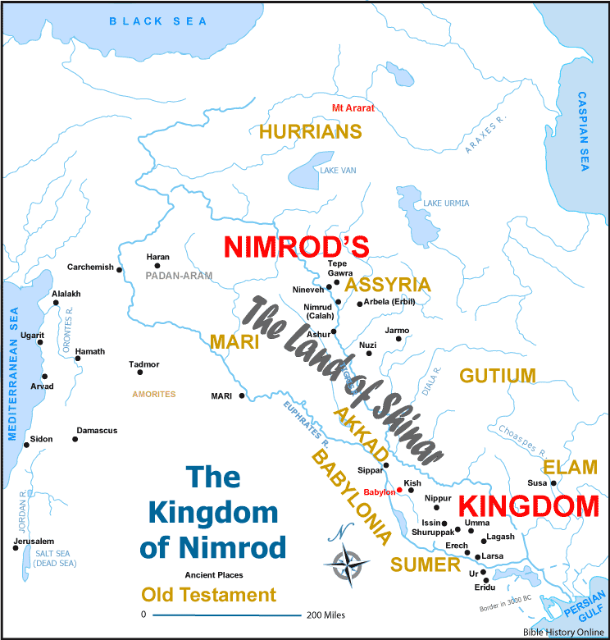
Babel in the Land of Shinar
Gen. 11:2, 4 – a plain in the land of Shinar
- let us build a city and a tower
Gen. 11:9 – the name of it called Babel [Babylon]
Gen. 14:1 – And it came to pass in the days of Amraphel, king of Shinar

Slide 162
The Nexus – Genesis Chapter 14 Another King-Priest
In the days of Amraphel King of Shinar (14:1)
A King-Priest in Another City (14:18)
Represents true system of worship and…
Line of the seed of the woman
…brought forth bread and wine, as he was the priest of the most high God, and he blessed them and said… (14:18-20)

Slide 163
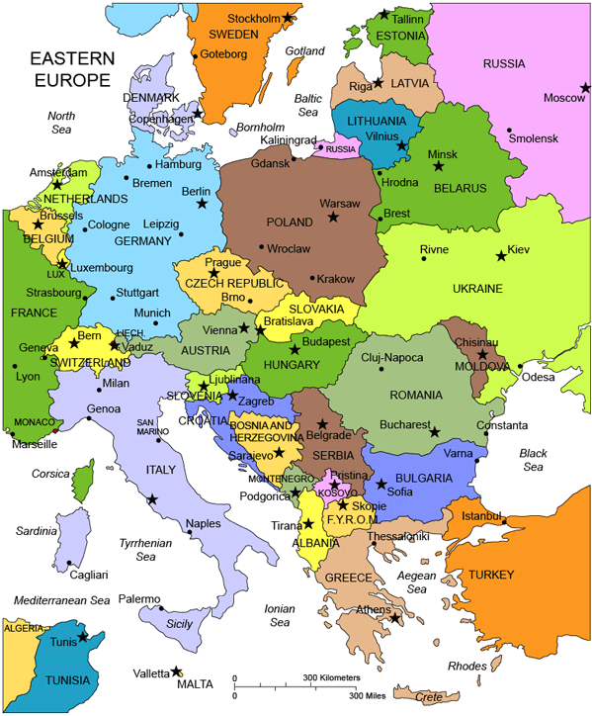
“Babylon’s” Geographical Shift
Phase 2
Phase 1

Slide 164
Stage 1 Stage 2
Set in Israel Set in Babylon (Europe) Ezekiel 38/39
Destruction of Gog in Israel Fire sent upon Magog in (39:4) Europe (39:6)
Daniel 2
Stone Strikes Image (2:34) Ground to Powder (2:35)
Revelation 14
1st Angel with Sickle 2nd Angel with Sickle
Grain Harvest “Armageddon”(14:15) Vine Harvest (14:18)
Revelation 16
Vial 6-Battle of Armageddon Vial 7 - Fall of Great Babylon (v. 19)
Notes:
Ben’s Part 2 – 23-25 mins.

Slide 165
Stage 1 Stage 2
Set in Israel Set in Babylon (Europe) Ezekiel 38/39
Destruction of Gog in Israel Fire sent upon Magog in (39:4) Europe (39:6)
Daniel 2
Stone Strikes Image (2:34) Ground to Powder (2:35)
Revelation 14
1st Angel with Sickle 2nd Angel with Sickle
Grain Harvest “Armageddon”(14:15) Vine Harvest (14:18)
Revelation 16
Vial 6-Battle of Armageddon Vial 7 - Fall of Great Babylon (v. 19)
Notes:
Ben’s Part 2 – 23-25 mins.

Slide 166
Stage 1 Stage 2
Set in Israel Set in Babylon (Europe) Ezekiel 38/39
Destruction of Gog in Israel Fire sent upon Magog in (39:4) Europe (39:6)
Daniel 2
Stone Strikes Image (2:34) Ground to Powder (2:35)
Revelation 14
1st Angel with Sickle 2nd Angel with Sickle
Grain Harvest “Armageddon”(14:15) Vine Harvest (14:18)
Revelation 16
Vial 6-Battle of Armageddon Vial 7 - Fall of Great Babylon (v. 19)
Notes:
Ben’s Part 2 – 23-25 mins.

Slide 167
Stage 1 Stage 2
Set in Israel Set in Babylon (Europe) Ezekiel 38/39
Destruction of Gog in Israel Fire sent upon Magog in (39:4) Europe (39:6)
Daniel 2
Stone Strikes Image (2:34) Ground to Powder (2:35)
Revelation 14
1st Angel with Sickle 2nd Angel with Sickle
Grain Harvest “Armageddon”(14:15) Vine Harvest (14:18)
Revelation 16
Vial 6-Battle of Armageddon Vial 7 - Fall of Great Babylon (v. 19)
Notes:
Ben’s Part 2 – 23-25 mins.

Slide 168
Summary of this Fundamental Bible “Story”
Seed of Woman Represents:
Seed of Serpent Represents:
Light of the Truth
Thinking of the Spirit
Darkness of error
Thinking of the flesh
Those Covenanted through Sacrifice
Those Estranged from God

Slide 169
Spiritual Adultery
How weak is thine heart, saith the Lord God, seeing thou doest all these things, the work of an imperious whorish woman;
In that thou buildest thine eminent place in the head of every way, and makest thine high place in every street; and hast not been as an harlot, in that thou scornest hire;
But as a wife that committeth adultery, which taketh strangers instead of her husband!
They give gifts to all whores: but thou givest thy gifts to all thy lovers, and hirest them, that they may come unto thee on every side for thy whoredom. Ezekiel 16:30-35
Notes:
Israel’s seeking after other gods, and their departure from the one true God of Israel, is described over and over as adultery with the nation described as a whore and a harlot.

Slide 170
Separation & Divorce
Surely as a wife treacherously departed from her husband, so have ye dealt treacherously with me, O house of Israel. Jeremiah 3:20
And I saw, when for all the causes whereby backsliding Israel committed adultery I had put her away, and given her a bill of divorce; yet her treacherous sister Judah feared not, but went and played the harlot also. Jeremiah 3:8
Notes:
Israel’s forsaking of God and departing from Him resulted in Him putting her away and writing her a bill of divorcement.

Slide 171
Not be for another man
And I said unto her, Thou shalt abide for me many days; thou shalt not play the harlot, and thou shalt not be for another man: so will I also be for thee.
For the children of Israel shall abide many days without a king, and without a prince, and without a sacrifice, and without an image, and without an ephod, and without teraphim:
Afterward shall the children of Israel return, and seek the Lord their God, and David their king; and shall fear the Lord and his goodness in the latter days. Hosea 3:3-5
Notes:
Hosea’s prophecy is very specific – during the period of Israel’s putting away, she shall not be for another man. Therefore, the condition of the Law which prevented the wife from returning to her original husband was never met. Israel was never married to ‘another’. They committed adultery and played the harlot, God divorced them but was never wed to another. The Law did not prevent a man from being restored to an unfaithful wife.

Slide 172
A Problem with the Types of Marriage & Divorce
They say, If a man put away his wife, and she go from him, and become another man's, shall he return unto her again? shall not that land be greatly polluted? but thou hast played the harlot with many lovers; yet return again to me, saith the Lord. Jeremiah 3:1
Notes:
One of the problems in explaining the figure of God’s relationship to Israel as a husband to His wife, Israel, arises because of the putting away for their iniquity. Under the Law, a wife was put away who became another man’s [Deut. 24:3-4] could not return to her original husband. How is it then that God speaks of taking Israel to wife again? The prophecy of Hosea answers this question.

Slide 173
The Exclusivity of Marriage
…helps us understand the exclusivity of God’s relationship to His people.
I am my beloved’s and my beloved is mine… Song of Solomon 6:3
Then they that feared the Lord spake often one to another: and the Lord hearkened, and heard it, and a book of remembrance was written before him for them that feared the Lord, and that thought upon his name.
And they shall be mine, saith the Lord of hosts, in that day when I make up my jewels; and I will spare them, as a man spareth his own son that serveth him. Malachi 3:16-17
Notes:
In marriage, there is a reciprocity and mutuality in the feelings for one spouse for the other [see 1 Cor. 7:4]. Among these feelings are godly jealously and possessiveness. The specialness of the relationship owes much to the fact that it is exclusive and that each is reserved wholly for the other. We see this in the figure of God’s bride in Song of Solomon and in the possessive form of speech in Malachi – “my people, mine, my jewels”. These are terms that indicate that they belong to Him and His desirous of their exclusive fellowship and marriage to Him.

Slide 174
Implications of being the People of God
Be ye not unequally yoked together with unbelievers: for what fellowship hath righteousness with unrighteousness? and what communion hath light with darkness?
And what agreement hath the temple of God with idols? for ye are the temple of the living God; as God hath said, I will dwell in them, and walk in them; and I will be their God, and they shall be my people.
Wherefore come out from among them, and be ye separate, saith the Lord, and touch not the unclean thing; and I will receive you.
And will be a Father unto you, and ye shall be my sons and daughters, saith the Lord Almighty.
Having therefore these promises, dearly beloved, let us cleanse ourselves from all filthiness of the flesh and spirit, perfecting holiness in the fear of God. 2 Corinthians 6:14-7:1
Notes:
We briefly referred to this passage in 2nd Corinthians when reviewing what the moral implications were of “getting out of Babylon”. It is also very relevant to the concept of our relationship to God and Christ and the concept of spiritual marriage. What is also interesting about this passage is that it is only 1 of 2 places in the NT where we find the very special phrase that we have been focusing on today – “I will be their God and they shall be my people”. Paul here is quoting as we know from the Law – Deut. 22:10 and as it was under the Law of Moses, our standing as the people of God is also conditional upon our moral performance. We must “not be unequally yoked together with unbelievers” and we must then “come out from among them and be ye separate and touch not the unclean thing.” These are the conditions under which God will then be our Father and we will be part of His family as His sons and daughters.

Slide 175
The Father-Spirit As The Center of God’s Family & All Creation
“The Father-Spirit, unveiled, is the focal center of the universe, from which irradiates whatever exists. as all things are “out of Him,”
It is embodied paternal power which implies offspring or children, children or son of power. Son-power is also embodied power. It is power emanating from the Father, corporealized in one or a multitude, but never separated or detached from the focal center. The Son-power is, therefore, the Father-power, multitudinously expressed, and manifested through many bodies”.
Phanerosis
John Thomas

Slide 176
Isaac – Abraham’s Only Begotten Son
Genesis 21:1-7, Genesis 22:2
Genesis 24:36, Genesis 25:6,11,19
Hebrews 11:11-12, 17
Isaac is presented in the scriptural record as being pre-eminently the miraculous son by whom God’s purpose would be foreshadowed, and in whom the fulfilment of the promises would begin.
Yahweh led Isaac through the atmosphere of a
godly family to be a faithful and obedient son, who manifested his father’s qualities even under the pressure of great trial.
Notes:
176

Slide 177
Yahweh Declared In A Son
“Isaac in his generation, or circumstances of his begettal; and in his figurative sacrifice and resurrection, was the representative of Christ to his father Abraham; by which he was taught:
That Christ the Son of the Woman was to be of preter-
natural paternity; and therefore, Son of Power or God
That he was to be killed as a sacrifice; and
That he was to be raised from the dead
These things were expressed, and implied in the representation; so that, had the question been put to Abraham, “What thinkest thou of the Christ? Whose Son is he?” He would have replied: “He shall be Son of God”.
John Thomas
Phanerosis, p. 72

Slide 178
Example of Ishmael
Genesis 21:9-14 - Ishmael had privileged status as the
firstborn son. But he revealed a completely different spirit to his father, and was therefore sent away.
John 8:33-42, Galatians 4:30 - The leaders in Christ’s day, scorned Christ. They therefore suffered the fate of Ishmael in being cast out of their father’s house.
Luke 13:27-29 - When the divine family of Abraham, Isaac and Jacob sit down in the kingdom, Christ will ask those who do not belong to that family to leave.
Sons who disgrace and scorn the father’s family principles will be rejected.
Notes:
178

Slide 179
The Yahweh Name And The Multitudinous Seed
Exodus 6:3 – “And I appeared unto Abraham, unto Isaac, and unto Jacob, by the name of God Almighty, but by my name Yahweh was I not known unto them”.
God acted as El or Ail Shaddai to the patriarchs to strengthen the very family into existence through whom the Name would be fulfilled.
It was only after Jacob died, and the multitudinous seed sprang forth, that Yahweh could establish his memorial name – Yahweh Elohim – He who will be manifested in a “multitude of mighty ones”.

Slide 180
The Elohim Of The Age To Come
Hebrews 2:5 - The Elohim of Abraham, the Elohim of Isaac, and the Elohim of Jacob are not the Elohim of the present order, but the Elohim of the age to come.
Psalm 89:6-7 - The angels hold the Deity in the deepest reverence and awe. Their attitude sets the benchmark for the Elohim of the age to come.
The prayers of the saints should reflect this same spirit of respect as we frame our words and thoughts such that they are consistent with the standard of the household of Abraham.

